Slide 1
Object Distance Estimation Using Kinect Sensor
Andrea Bersellini

Slide 2
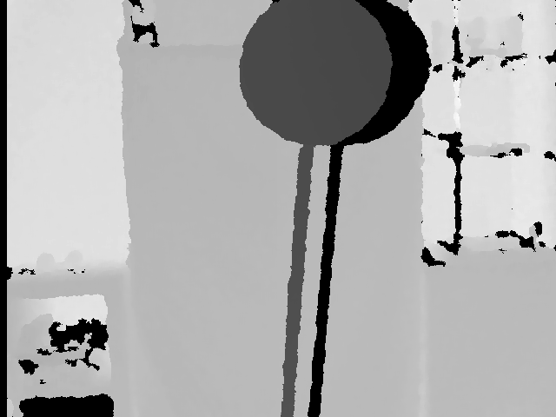
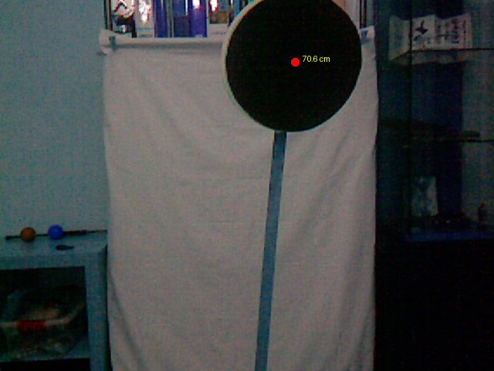
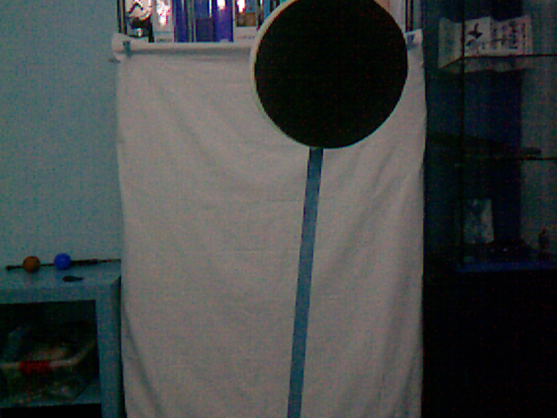
Proof Of Concept

Slide 3
Intrinsic Calibration
90cm
120cm
DISTANCES
4.5
0.5
m = (value1 - value0) / (calib_distance_1 - calib_distance_0)
dist0 = (0 - (value1 - m * calib_distance_1)) / m
dist255 = (255 - (value1 - m * calib_distance_1)) / m
RGB VALUES
0
255

Slide 4
Extrinsic Calibration
RADIUS = 20
RADIUS = 25
scale_factor = depth_radius / color_radius

Slide 5
Processing Pipeline
Calibration of the images
Coordinate point of the object
Depth information of the point
Distance of the object

Slide 6
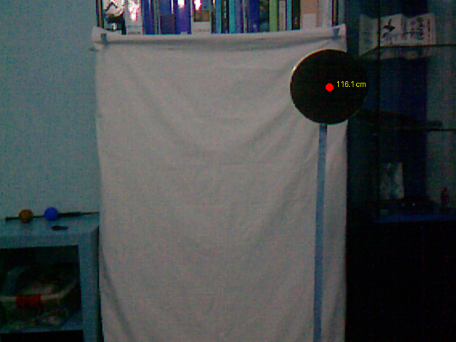
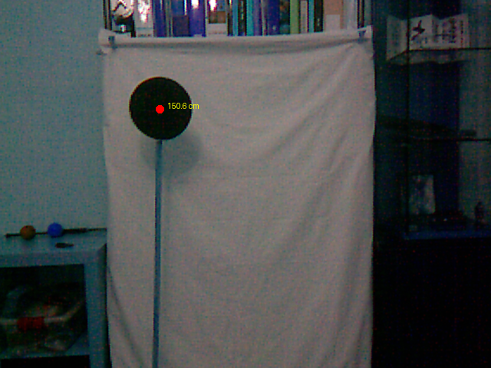
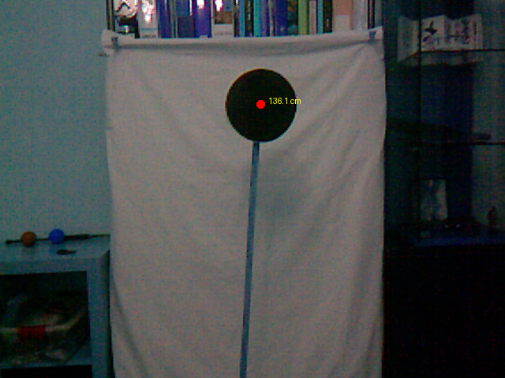
Final Results
LABLE | MEASURED | PREDICTED
Image 1 | 120 | 116
Image 2 | 152 | 151
Image 3 | 134 | 136
Image 4 | 71 | 71
Image 5 | 104 | 105

Slide 7
Causes Of Error
Calibration Measurement Approximation
Non-linearity in Grayscale Value Mapping
Inconsistency of Kinect Image Acquisition

Slide 8
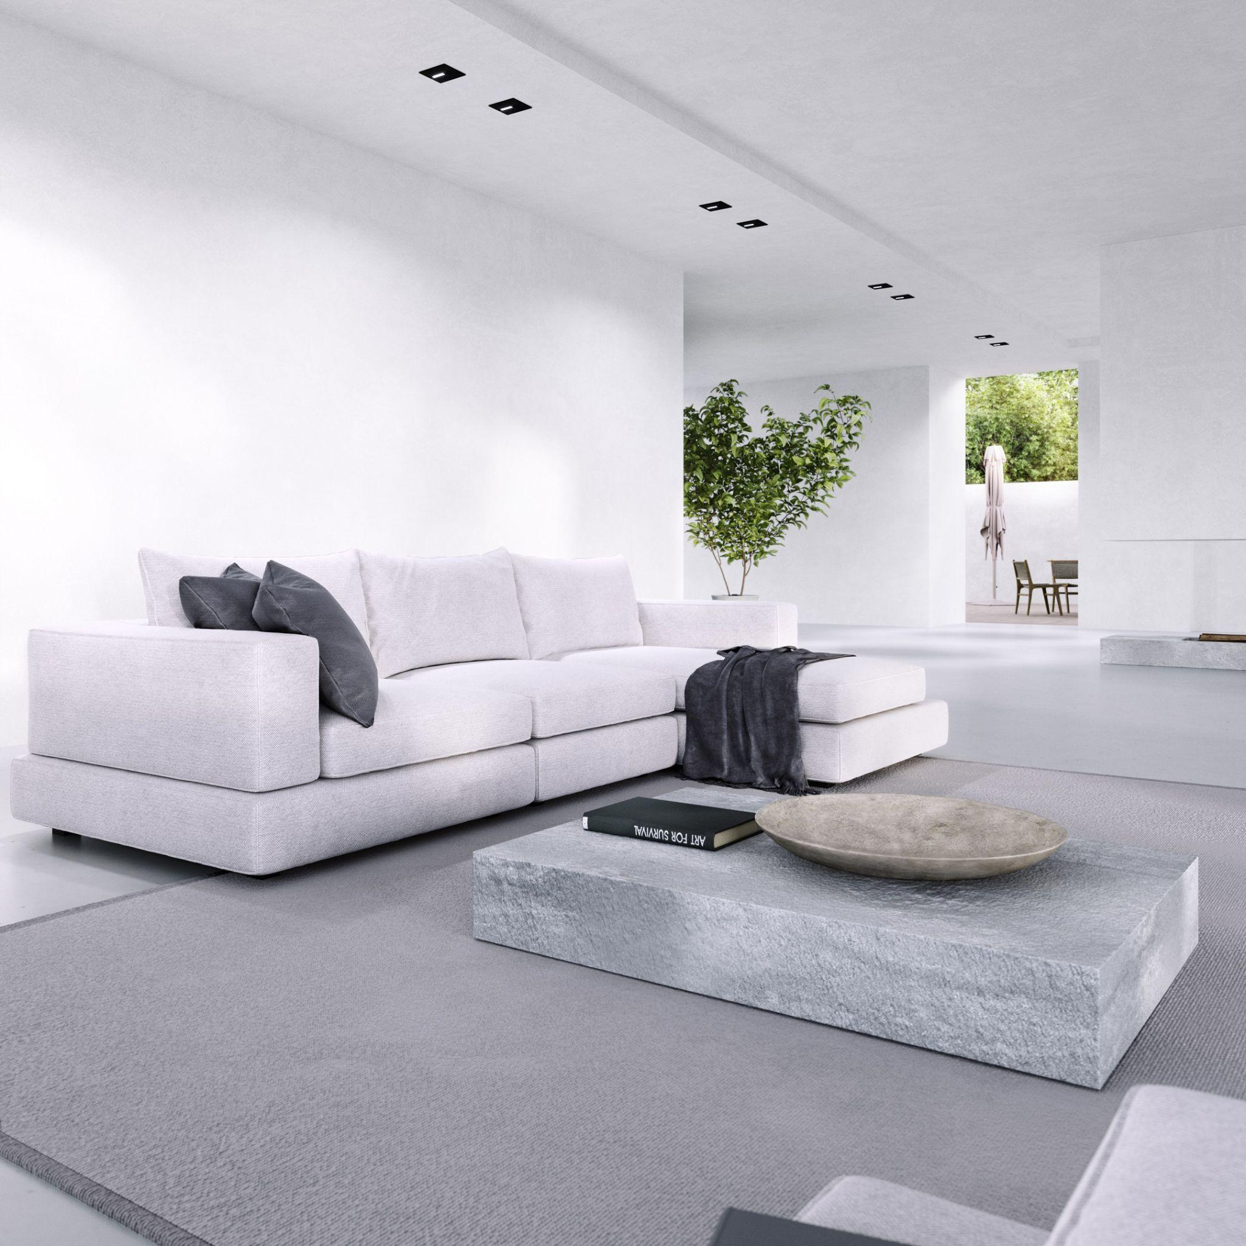
Applications
Robotics Perception
Robotics Localization
Building
Design

Slide 9
Thanks for the attention!

